Slide 1

After completing this chapter you will be able to:
  Apply Access Modifiers
  Develop a java method
  Explain encapsulation
  Overload a method
  Use static keyword
  Understand Constructors
  Overload the constructor

Slide 2




In my Facebook Profile page, I do not wish to share some personal information like my “age”. But, I would like to share my “email id” with my friends and I would like everyone to be able to access my “school/university” details. How do I do this?
FaceBookProfile
No access: Age
private access: EmailId
Public access: School
Face book application has features where users can select what level of access to be provided to their profile information.

Slide 3

Similarly when developing java application developers needs to secure their methods/ variables by defining different access level.
This is achieved using “Access Modifiers"

Slide 4

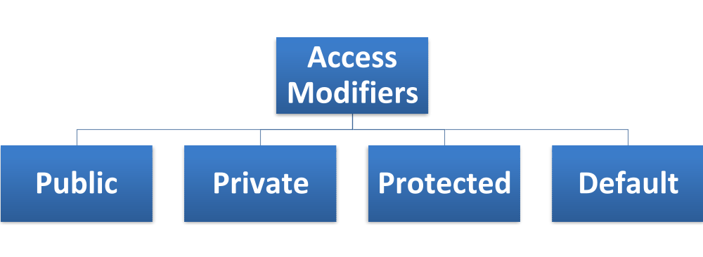
What are access modifiers?
  The scope of a variable/methods can be defined by using access modifiers.
Analogy to the Facebook Example:
School details can be made public (can be accessed by any class)
Age can be made private (to be accessed only by the same class)
Email Id can be left as default (to be accessed only by the classes in same package)

Slide 5

What is public access?
  Public access specifies that the class members (variables or methods) are accessible to anyone, both inside and outside the class and outside of the package.
Syntax: public <method/variable name>
Example:
  Public variable:
    public int x = 0;
  Public Method:
public addNumbers(int x, int y){
// some code here
}

Slide 6

Illustration for public access:
  Assume there are 3 java classes A, B, and C
  Classes A & B are in the same package where as Class C is in a different package
  Class A has a public variable
  Class B will be able to access the public variable in Class A
  Class C will be able to access the public variable in Class A
Same Package Another Package
B A
C
public

Slide 7

What is private access?
  Private access specifies that class member are only accessible by the class in which they are defined. Cannot be accessed by any other class.
  Syntax : private <variable/method name>
Example:
  Private variable:
    private int x = 0;
  Private Method:
private addNumbers(int x, int y){
// some code here
}

Slide 8

Illustration for private access:
Taking the same example illustrated before
Class A has a private variable
Class B will not be able to access the private variable in Class A
Class C will not be able to access the private variable in Class A
Only methods in class A can access the private variable in Class A.
Same Package Another Package
B A
C
private

Slide 9

What is protected access?
  Protected access specifies that the class members/methods are accessible to only the methods in that class, classes from same package and the subclasses of the class. The subclass can be in any package
Syntax: protected <variable/method name>
Example:
  Protected variable:
    protected int x = 0;
  Protected Method:
protected addNumbers(int x, int y){
// some code here
}

Slide 10
Illustration for protected access:
Class A has a protected variable.
Protected variable in Class A can be accessed by Class B in the same package
It can be accessed by class D since Class D is a subclass of Class A
It cannot be accessed by class C since class C is in a different package and is not a sub class of class A.
Same Package Another Package
B A
C D extends A
protected

Slide 11

What is default access?
  Default/No access specifies that only classes in the same package can have access to the variables and methods of the other class
  No keyword is required for the default modifier and it is applied in the absence of an access modifier.
Same Package Another Package
B A
C
default

Slide 12

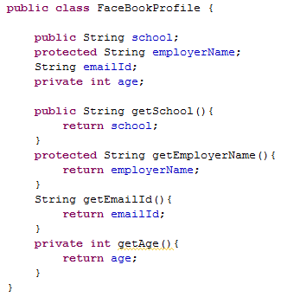
Public access to school variable
Protected access to employerName variable
Default/no access to emailId variable
Private access to age variable
Public access to getSchool method (Everyone can access)
Protected access to getEmployerName method
(Package & subclass access)
Default/no access to getEmailId method (Package access only)
Private access to
getAge method (Access within class only)

Slide 13

Access Modifiers | Same Class | Same Package | Subclass | Other packages
public | Y | Y | Y | Y
Protected | Y | Y | Y | N
No access modifier | Y | Y | N | N
Private | Y | N | N | N
Public and private are the commonly used access specifiers in projects.

Slide 14

What is a method?
  A method is a set of statements to perform a desired functionality which can be included inside a java class.
  This set of statements can be called (invoked) at any point in the program by using the method name.
  Example: main method in class A invokes method “add” in class B and method “multiply” in class C.
ClassB{
add(){
//write code here
}
}
ClassA{
public static void main{
  Statement 1
  add();
  Statement 2
  multiply();
}
}
ClassC{
multiply(){
// write code here
}
}

Slide 15

How to declare a method?
  Syntax:
    <modifier> <returnType> <methodName>(<parameter>*) {
    <statement>*
    }
  Example:
  public int add(int x, int y){
  int sum = x+y;
  return sum;
  }
  is the parameter or arguments passed to this method. These values are used inside the method. Any number of arguments can be passed
  is the access <modifier> that specifies the visibility of the method.
  is the statements present inside the method that perform the actual function
  is the <returnType> that indicates the data type of the return value.
  is the name of the method. This can be any meaningful word that describes the purpose of the method
  is the result value that is being sent back to the calling method

Slide 16



What is encapsulation?
The actual medicine is hidden inside the capsule. The patient is not aware of the contents of the medicine.

Slide 17

What is Encapsulation?
  Encapsulation is one of the fundamental OOP concepts
  It is the protective barrier that prevents the data in a class from being directly accessed by the code outside the class.
  Access to the data and code is tightly controlled by using an interface.
  Example: In Face book people don’t share their age information.

Slide 18

How is Encapsulation done?
  The fields in a class are made private so that it cannot be accessed by anyone outside the class.
  Hence encapsulation is also called “Data Hiding”.
  The fields can be accessed only by using the public methods in the class.
  Encapsulated data is accessed using the “Accessor (getter)” and “Mutator (setter)” methods.
    Accessors – Methods to retrieve the hidden data.
    Mutators – Methods to change hidden data.

Slide 19


Encapsulation are used to create value or transfer objects.
Transfer objects are used to logically bundle the related data and transferring it to another object.
Example: EmployeeVO – variables like employeeId, salary will be encapsulated and exposed using getters/setters.
VO stands for Value Object.
Confusing, you will learn more about value objects during your design pattern session.

Slide 20

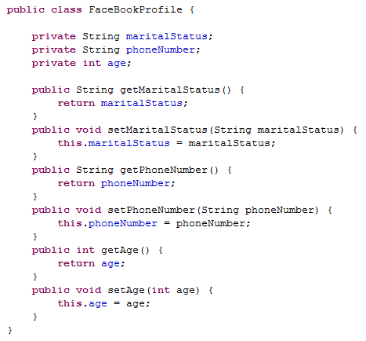
Let us look at an example of encapsulation,
In our FaceBook profile, we would like to hide the age, marital status and phone number information to the external world. This can be done using encapsulation where the fields are made private and can be accessed only by the accessor and mutator methods.
The public methods are access points to the fields of this class. Hence, any class that wants to access the variables should access them through these getters and setters

Slide 21
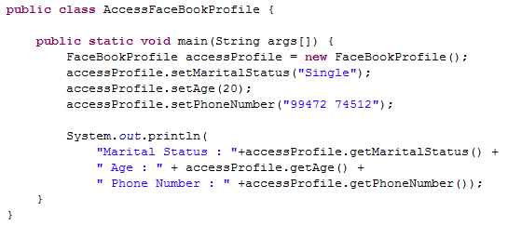
The variables of the EncapTest can be accessed as follows
The fields are set using the setter (Mutator) methods.
The values are got using the getter (Accessor) methods.

Slide 22

How to return from a method?
  A method returns a value using the return keyword.
  Syntax:
      return <return Value>;
  Where,
  <return Value> denotes the variable whose value needs to be returned.
  The datatype of the “return Value” must match the data type specified in the method declaration.
  i.e. You cannot return an integer variable value from a method which is declared to return a boolean.
  Returning control: If the method execution needs to be stopped and the control needs to be sent back to the calling method simply use the return keyword without the variable.
      Syntax: return;

Slide 23

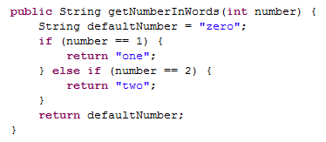
Multiple Return Statements:
A method can have multiple return statements
You can use constants as return values instead of variables
Below is an example of a code having multiple return statements
A constant value is being returned
Returning a variable value
NOTE: It is NOT a good practice to have multiple return statements from a method.
Let us look at a solution to fix this Best Practice violation in the next slide !!

Slide 24
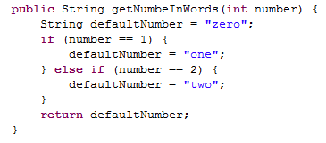
Best Practice: A method should have only one return statement
Value stored in a variable and returned from a single point

Slide 25

Let us all develop a program with a method invocation
Create a Java class “Square.java” with a method “calculateArea”
This method should accept length as an argument, calculate the area and return the area.
The main method should invoke the Square objects “calculateArea” method by passing a value for the length, say 20.
The main method should also print the area (result).

Slide 26

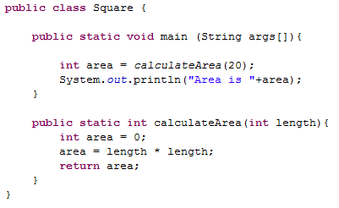
Solution:

Slide 27



What is method overloading?
Let us recollect what we learnt in the “Introduction to OOPS” session
Implementation 1:
makeSound()
{
  Bark woof woof
}
Implementation 2:
makeSound(injured) // Added input parameter, overloaded method.
{
  Make a whining sound.
}
Yes, You got It
    If not, go to the next slide for the definition !!

Slide 28
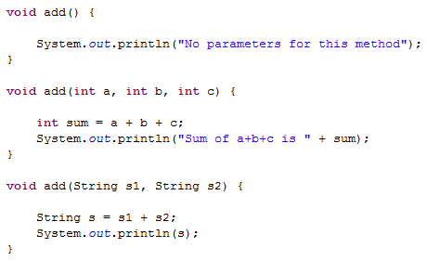
What is method overloading?
  Two different versions of the same method available in the same class.
  This can be done by changing the input parameter .
Example: The method “add” has been overloaded below,

Slide 29

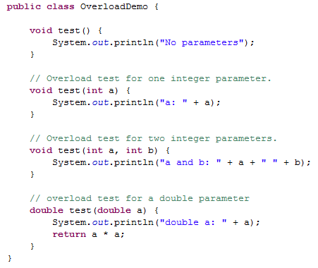
Let us all create 4 overloaded methods for “test()” and invoke all versions of the overloaded methods !!

Slide 30
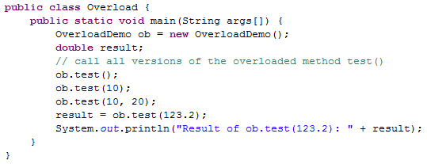
Create another class Overload.java which has a main method to call the overloaded methods in OverloadDemo.java

Slide 31

Static keyword:
The static keyword is used before a method or variable (similar to an access modifier).
Examples:
  variable: private static int x = 0;
  method: public static add(){
  // some code here
      }
Dictionary Definition of static:
Changeless, motionless

Slide 32
What is a static member?
  Static variables are global variables, which is shared by all the instances of the class.
  Static means that there will only be only one instance of that object in the class.
  It is not required to create an instance of the object to access the static method or variable.
Where is it used?
Static variables are used in singleton implementation. You will learn more about this during the design pattern session.

Slide 33

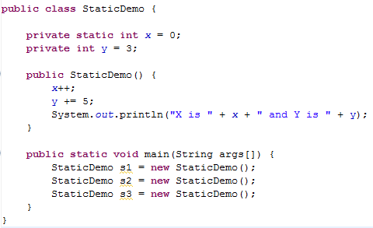
Let us all understand static variables using an example. Develop the code and look at out static is different from a normal variable.

Slide 34


The output of the program is below.
Reason:
Before s1 is created, X = 0 and Y = 3;
When s1 is created, X = 1 and Y = 8 (as per logic inside constructor)
When s2 is created, X = 2 since the value of X does not change with every instance. The value of X is shared across all instances.
But Y = 8 (since a new object of Y is created and incremented by 5.
Similarly, when s3 is created, X = 3 and Y = 8

Slide 35

What is a static method?
A "static" method belongs to the class, not to any particular instance. In other words, static methods can be invoked using the class name
Where is it used?
Static methods are used in singleton implementation. You will learn more about this during the design pattern session.

Slide 36

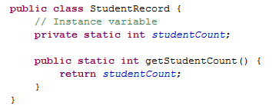

Let us develop the following code and get accustomed to static method declaration and invocation. The static method getStudentCount() can be accessed directly using class name.

Slide 37

What is a constructor?
  A constructor is a special method used for creating an object of a class and initializing its instance variables
  Constructors should have the same name as the class
  It should not have any return, not even void.
  It is not mandatory for the developer to write a constructor.
  If constructor is not defined by developer java will use the default constructor to create objects.

Slide 38

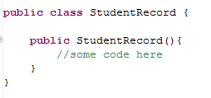
Default Constructor (no-arg constructor):
  A constructor with no parameters
  If the class does not specify any constructors, then an implicit default constructor is automatically called by the JVM.
Syntax:
Default Constructor

Slide 39

What is overloaded constructor?
  A default constructor with one or more arguments is called a overloaded constructor
How to overload constructors?
  Step 1: Create a method with the same name as the class name
  Step 2: Do not provide any return type for the method created
  Step 3: Add required number of arguments for the constructor (method) to create an overloaded constructor
  Step 4: Any number of overloaded constructors can be created for a class.

Slide 40

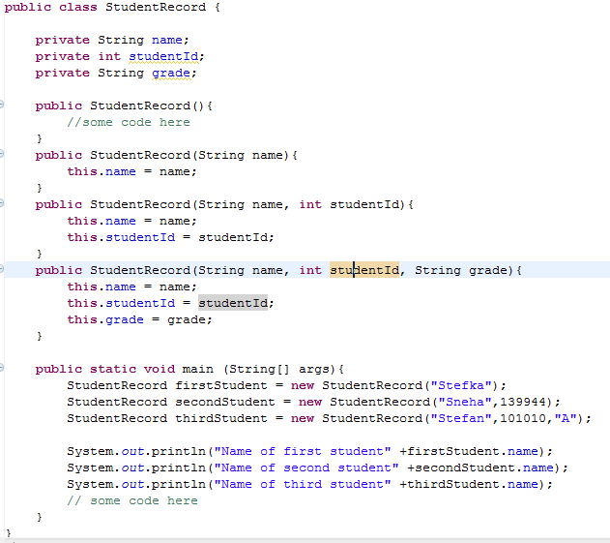
Lets all create this class and overload the constructors as illustrated.
Default Constructor
Overloaded Constructors
Objects instantiated using different constructors

Slide 41

The “this” keyword:
  “this” refer to the current object instance itself.
  It can be used for only instance variables and not for static or class variables
  It is used for also invoking the overloaded constructors.
  It is used to access the instance variables shadowed by the parameters in methods. Typically used with the encapsulated field.
  Example: A method calculateTax has a parameter salary, also the class has the instance variable salary. In the method if we refer using “this” keyword it means we are referring to instance variable.
  Syntax:
  this.<name of instance variable>
    this.<constructor Name><arguments>

Slide 42

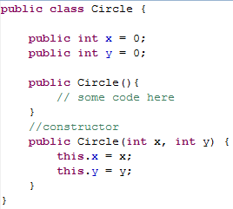
The member variables are being referred using the this key word.

Slide 43

Chaining Constructor Calls:
Constructor calls can be chained, which mean you can call another constructor from a constructor of the same class.
You can use “this()” for invoking constructors from other constructor of a class.
There are a few things to remember when using this() method constructor call:
  When using “this()” constructor call, it must occur as the first statement in a constructor.
  The “this()” call can then be followed by any other statements.

Slide 44

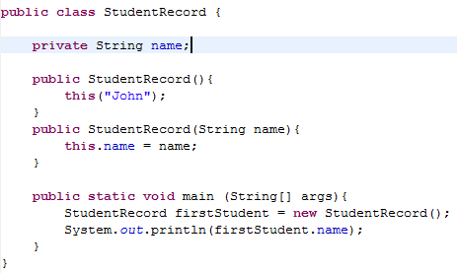
Example of constructor chaining using “this()” reference
The overloaded constructor is being invoked by the default constructor using this()

